Slide 1

WELCOME

Slide 2
TEAM MEMBERS
SADIA KHAN 233544
SOMAL ATTA 233530
DANISH BUTT 233606 (LEADER)

Slide 3


Title: INVENtory management system
.

Slide 4
Objectives
Project Goals:
Stock Optimization Avoid overstocking or stockouts by maintaining ideal inventory levels.
Real-Time Inventory Tracking Achieve accurate stock monitoring to reduce errors and improve stock visibility.
User-Friendly Experience Provide an intuitive interface for easy navigation and quick operations.

Slide 5
Introduction
An Inventory Management System (IMS) is a software solution designed to monitor, manage, and optimize inventory levels, sales, purchases, and stock movements within an organization.
Inventory Management System streamlines inventory operations for businesses of all sizes.
Addresses challenges of traditional inventory methods with advanced features.

Slide 6

KEY FEATURES Product Registration: Add, update, or remove products with detailed attributes like SKU, category, and price. Real-Time Updates: Automatically updates stock levels with every sale, purchase, or adjustment. Multi-location Support: Tracks inventory across multiple warehouses or store locations.. Stock Movement History: Logs all inflows, outflows, and adjustments. Supplier and Vendor Management: Maintains supplier details and purchase histories.

Slide 7
FUNCTIONALITIES
Login and Registration
Secure login page for users with role-based access.
Registration feature for adding new users with appropriate roles
Dashboard
Provides a summary of inventory levels, recent activities, and alerts.
Order Processing:
Create purchase and sales orders with detailed line items.Track order statuses and update inventory accordingly.

Slide 8
FUNCTIONALITIES
Inventory Movements:
Record stock inflows, outflows, and adjustments.
Support for multi-location stock transfers.
Reporting:
Generate real-time reports on stock valuation, sales trends, and demand forecasting.

Slide 9

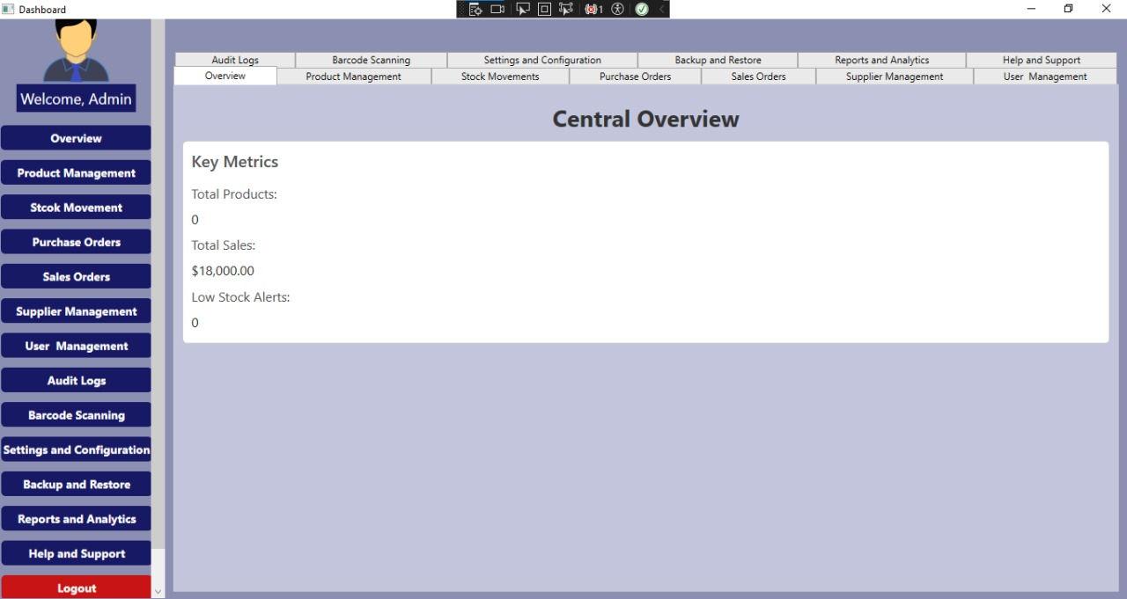
User Interface Components
Dashboard
Product Management
Inventory Tracking
Purchase Order Management
Sales Order Management
Reports and Analytics
User Management
Notifications Center

Slide 10
Database Design Overview
Products Table:
Stores product details, including SKU and stock levels.
Suppliers Table:
Maintains supplier information and links to purchase orders.
Purchase Orders Table:
Records purchase orders with statuses and total amounts.

Slide 11
Inventory Tracking
Real-Time Stock Updates:
Automatically updates stock levels during sales, purchases, or adjustments.
Multi-location Support:
Tracks inventory across multiple warehouses or store locations.
Batch and Serial Tracking:
Manages products by batch, lot, or unique serial numbers for traceability.
Stock Movement History:
Maintains a log of all stock movements (inflows, outflows, adjustments).

Slide 12
Product Management
Product Registration:
Add, update, or remove products with details such as SKU, category, and price.
Barcode Integration:
Generates and scans barcodes for quick product identification.
Categorization:
Organizes products into categories or groups for easier management.
Unit of Measure Support:
Manages inventory with various units (e.g., boxes, pieces, kg).

Slide 13
Order Management
Purchase Order Management:
Creates, tracks, and manages purchase orders from suppliers.
Sales Order Management:
Processes customer sales orders and links them to inventory.
Reorder Point Alerts:
Sends alerts when stock levels drop below a defined threshold.
Supplier and Vendor Management:
Maintains supplier details and purchase history.

Slide 14
User Management
Role-Based Access Control:
Defines user roles (Admin, Manager, Staff) with specific permissions.
User Authentication:
Secures login with password encryption.
Audit Logs:
Tracks and logs user actions for accountability.

Slide 15
Stock Control Features
Stock In/Out Transactions:
Records inventory inflows (purchases) and outflows (sales).
Stock Transfers:
Moves stock between different locations or warehouses.
Stock Adjustment:
Adjusts stock levels due to shrinkage, damage, or other factors.

Slide 16




Security and Compliance
Protects sensitive data with encryption during storage and transmission.
Data Encryption
Implements automated backups and disaster recovery plans.
Backup & Recovery
Ensures compliance with industry regulations (e.g., GDPR, ISO).
Compilance & Support

Slide 17
Integration and Automation
Accounting Integration:
Syncs inventory data with accounting systems like QuickBooks or Xero.
E-commerce Integration:
Integrates with platforms like Shopify or WooCommerce for real-time updates.
Email and Notifications:
Sends alerts and updates via email or in-app notifications.

Slide 18
Reports and Analytics
PURCHASE AND SALES ORDER MANAGEMENT
-Create and manage purchase orders from suppliers. -Process customer sales orders and link them to inventory. -Features include supplier selection, customer details, and order status tracking.
Generates reports and visualizes data for better decision-making.
Includes inventory valuation, sales trends, and stock movement analytics.

Slide 19
Database Design Overview
Sales Orders Table
Tracks customer sales orders and their statuses.
Categories Table:
Organizes products into categories for easier management
Stock Movements Table:
Logs all stock inflows, outflows, and adjustments.

Slide 20


Database Design Overview
Audit Logs Table
Ucg
User Table
Manages user accounts and roles.
Records user actions for accountability.

Slide 21
Enhanced Theme and User Interface Design
Visual Design:
Dark blue theme for a modern and professional appearance.
Reduces eye strain and enhances usability during prolonged usage.
Scroll Bar Integration:
Automatic scroll bars in critical areas for smooth navigation.
Ensures users can browse through extensive datasets easily.
Icon Integration:
Intuitive visual cues improve usability and provide a polished aesthetic.

Slide 22
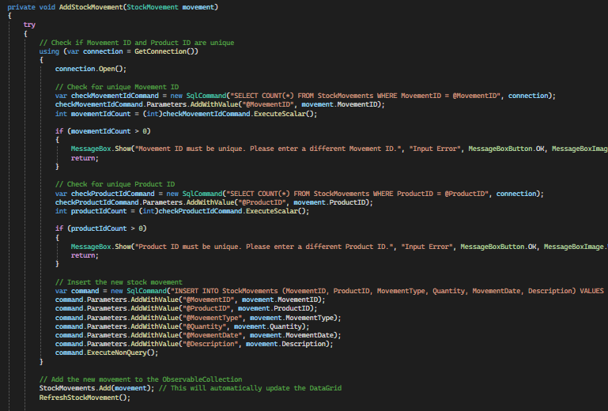
Backend Code Snippet

Slide 23
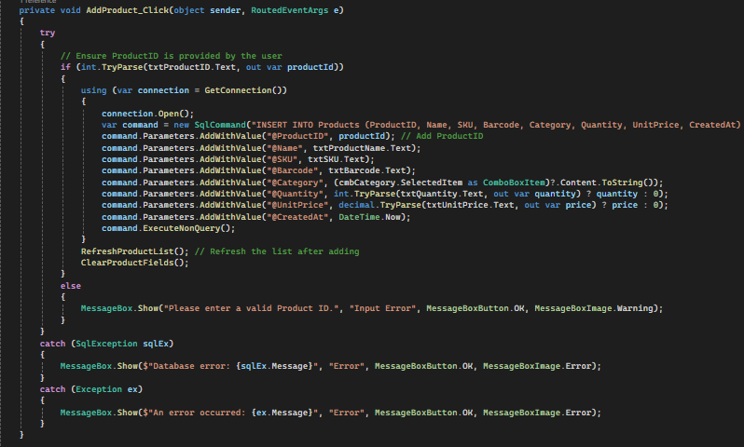
Backend code snippet

Slide 24
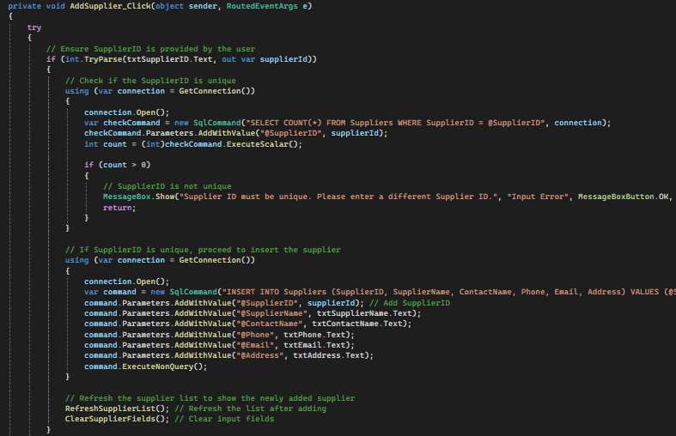
Backend Code Snippet

Slide 25
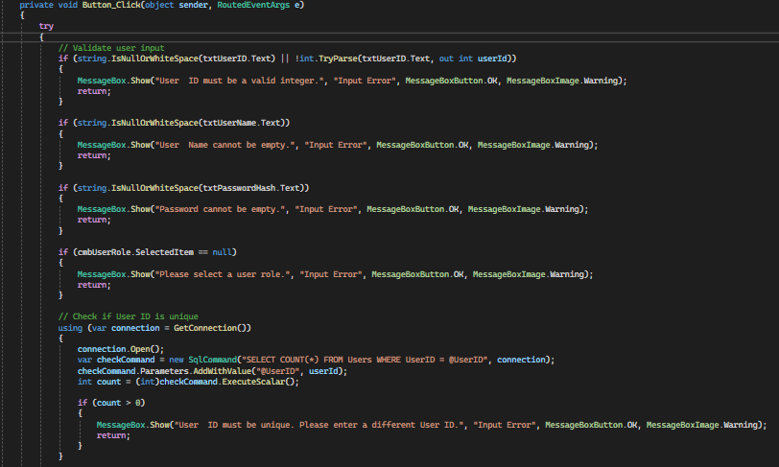
Backend code snippet

Slide 26
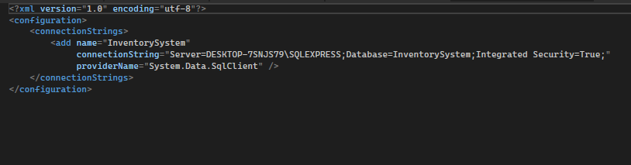
Backend Code Snippet

Slide 27
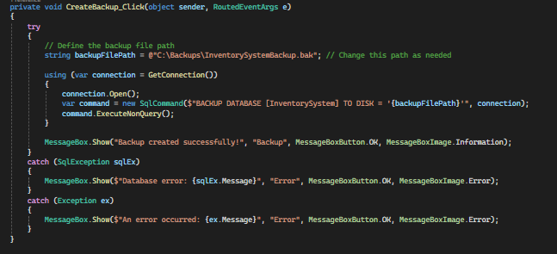
Backend code snippet

Slide 28
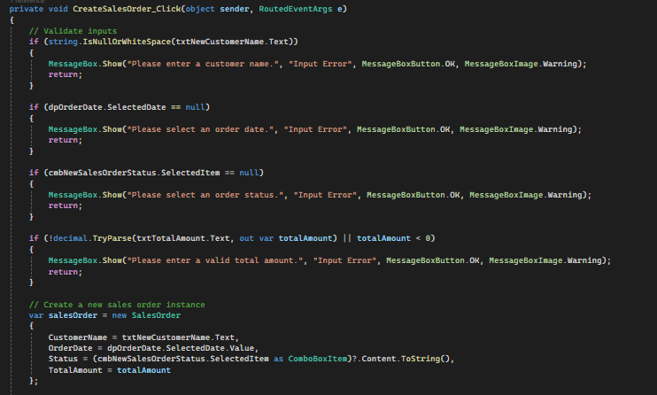
Backend Code Snippet

Slide 29
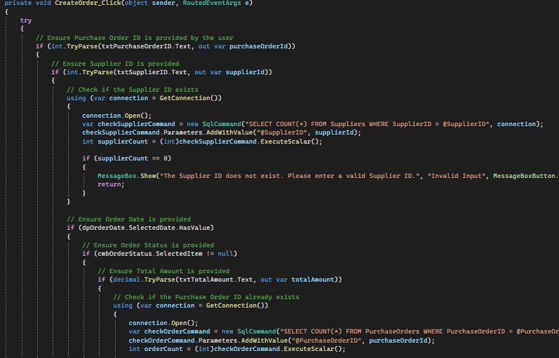
Backend Code Snippet

Slide 30
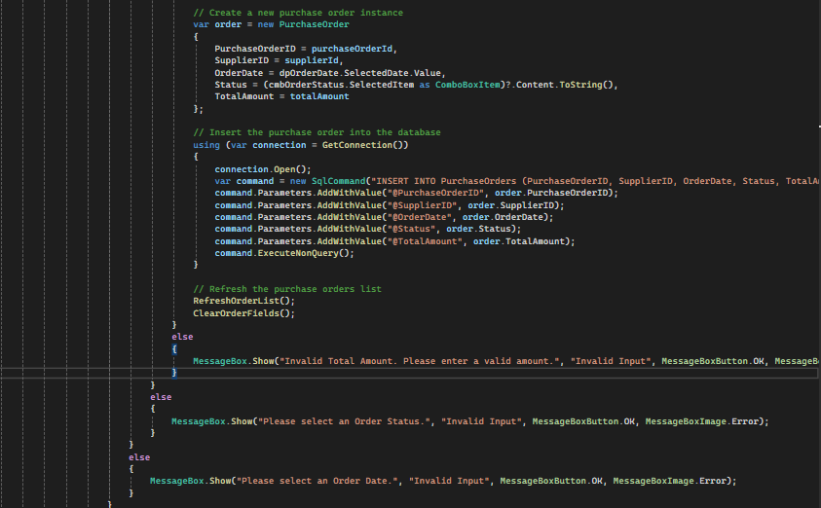
Backend code snippet

Slide 31
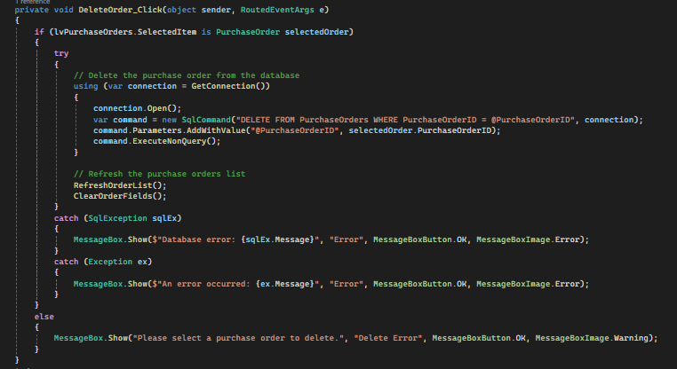
Backend code snippet

Slide 32
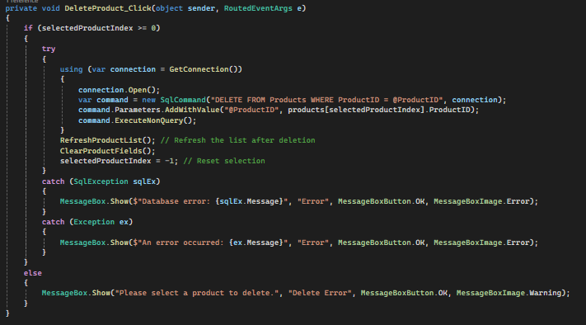
Backend code snippet

Slide 33
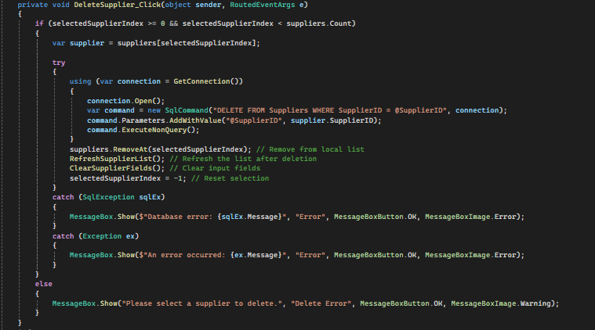
Backend code snippet

Slide 34
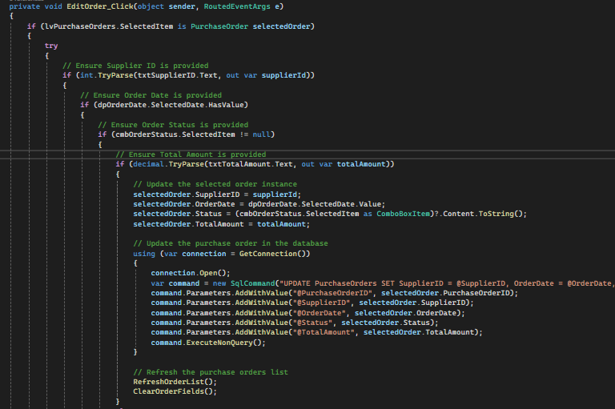
Backend code snippet

Slide 35
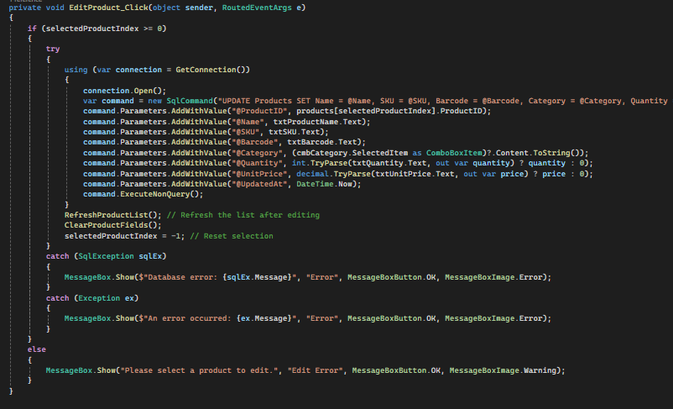
Backend code snippet

Slide 36
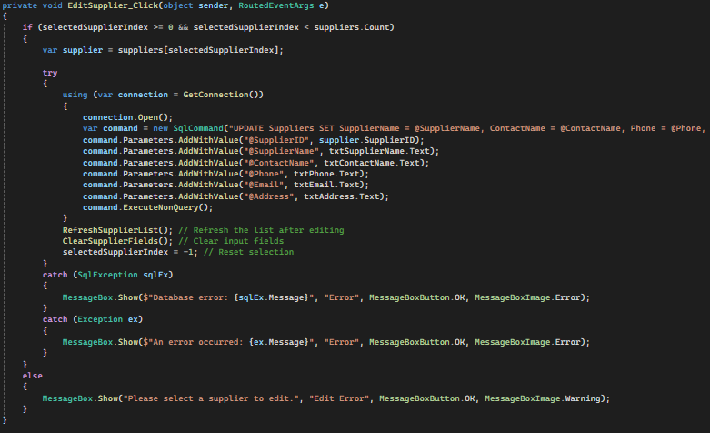
Backend code snippet

Slide 37
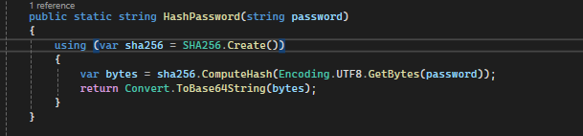
Backend code snippet

Slide 38
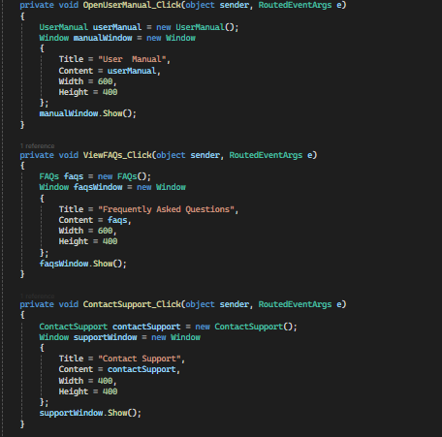
Backend code snippet

Slide 39
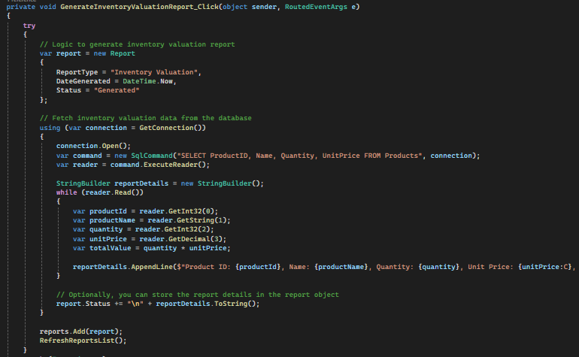
Backend code snippet

Slide 40
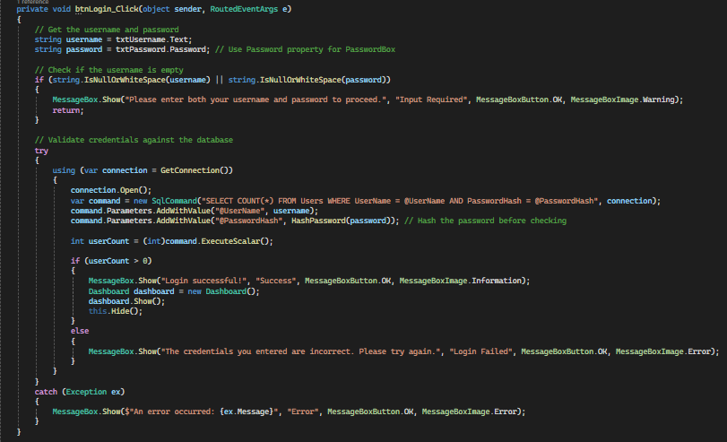
Backend code snippet

Slide 41
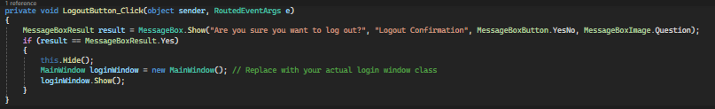
Backend code snippet

Slide 42
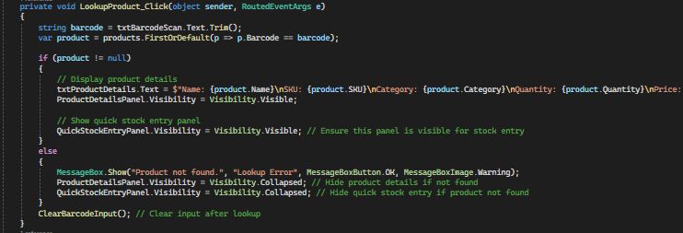
Backend code snippet

Slide 43
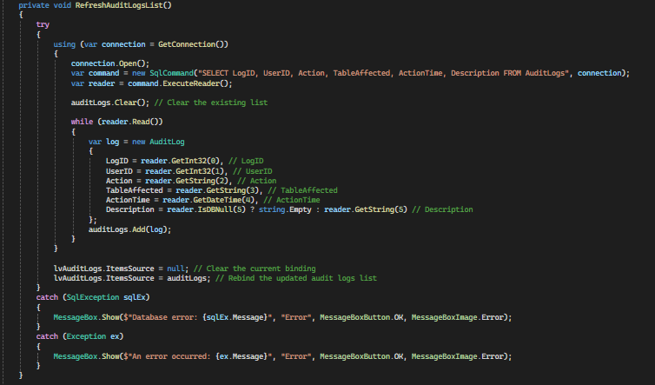
Backend code snippet

Slide 44
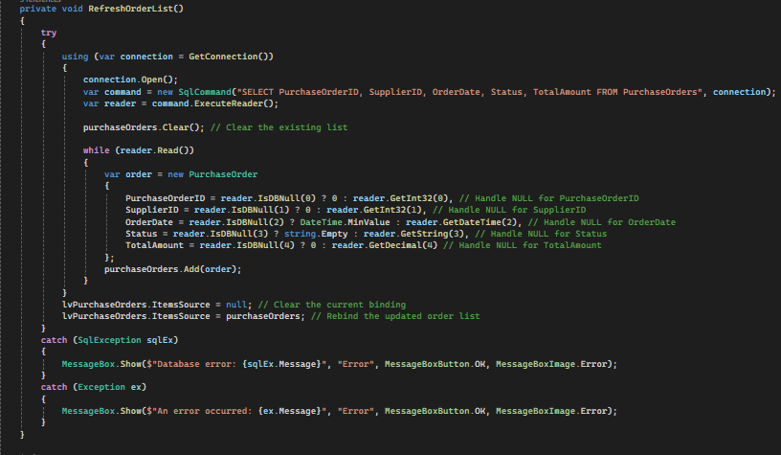
Backend code snippet

Slide 45
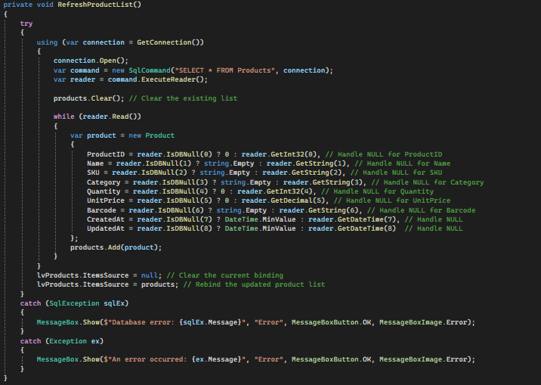
Backend code snippet

Slide 46
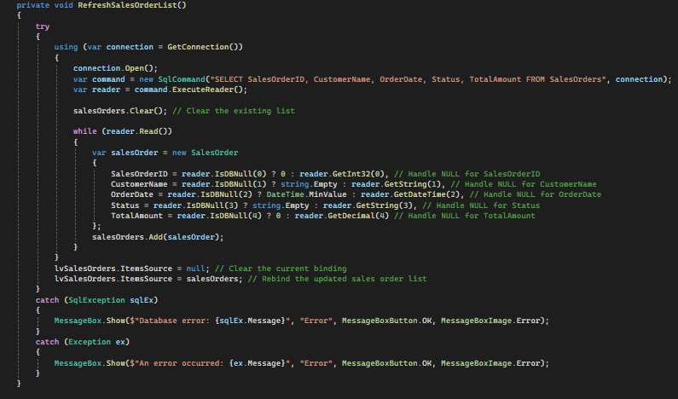
Backend code snippet

Slide 47
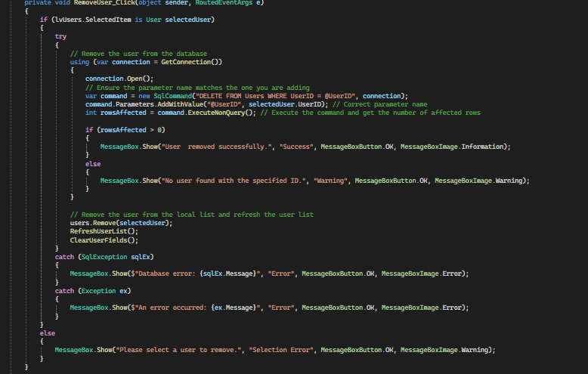
Backend code snippet

Slide 48
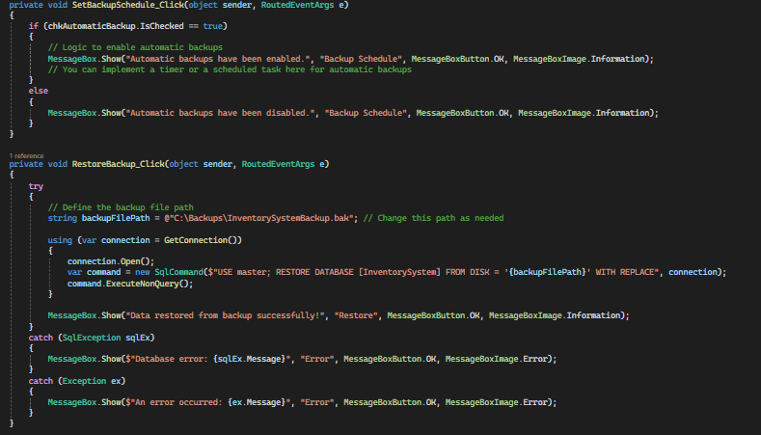
Backend code snippet

Slide 49
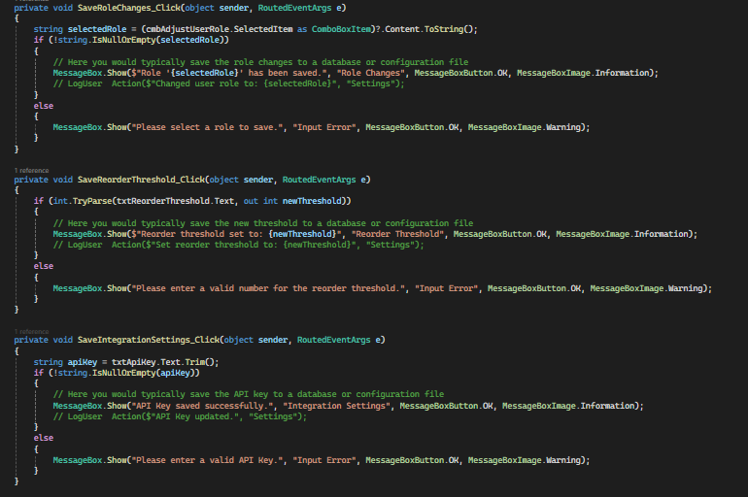
Backend code snippet

Slide 50
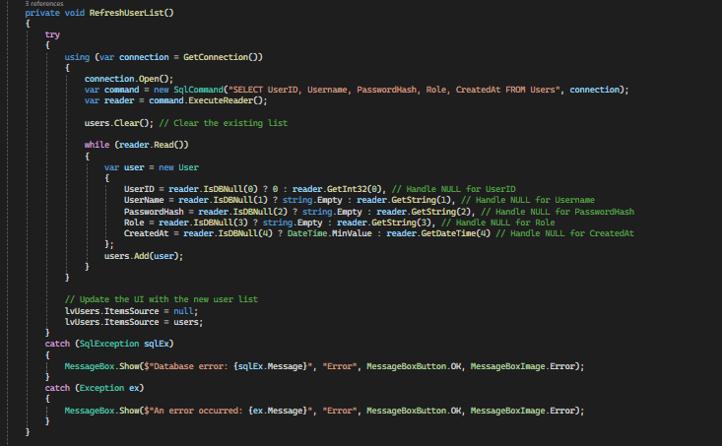
Backend code snippet

Slide 51
Backend code snippet

Slide 52
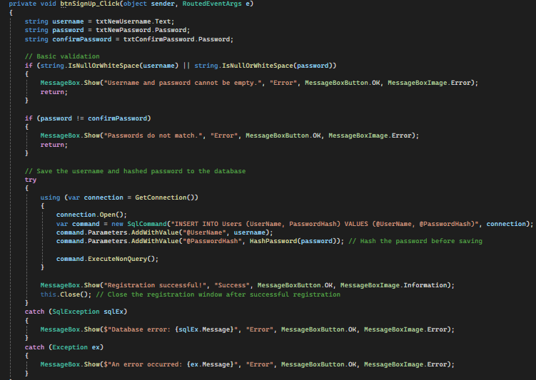
Backend code snippet

Slide 53
Backend code snippet

Slide 54
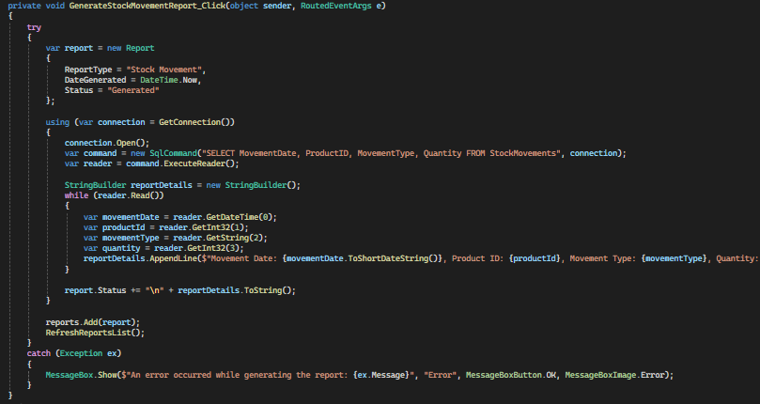
Backend code snippet

Slide 55
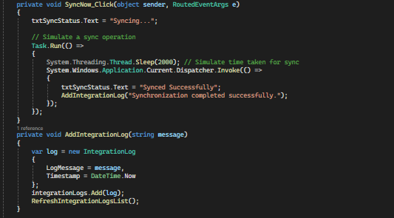
Backend code snippet

Slide 56
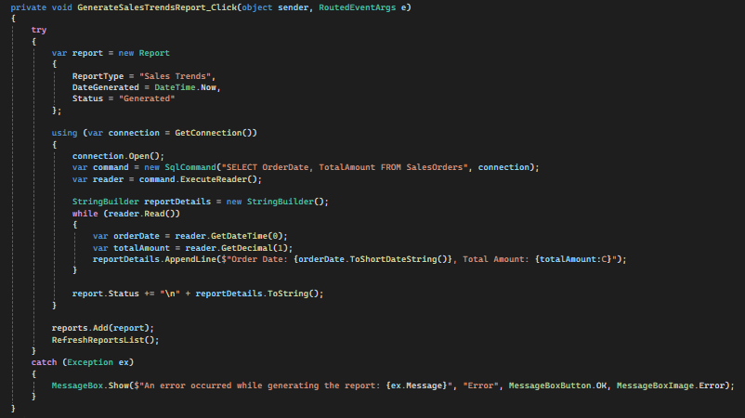
Backend code snippet

Slide 57
Backend code snippet

Slide 58
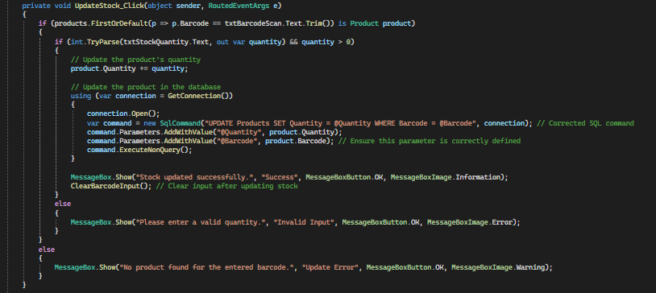
Backend code snippet

Slide 59
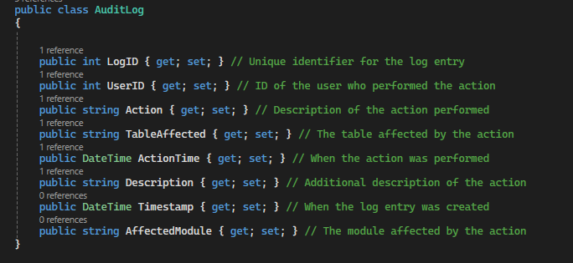
Code Snippet

Slide 60
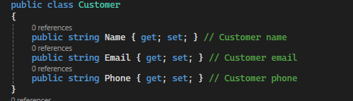
Code Snippet

Slide 61
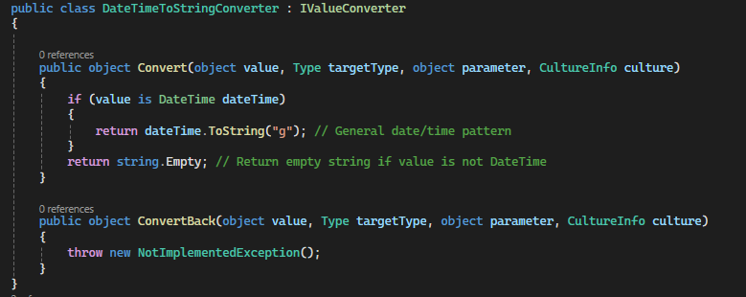
Code Snippet

Slide 62
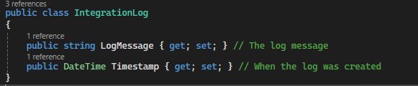
Code Snippet

Slide 63
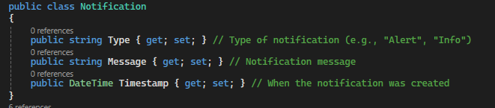
Code Snippet

Slide 64
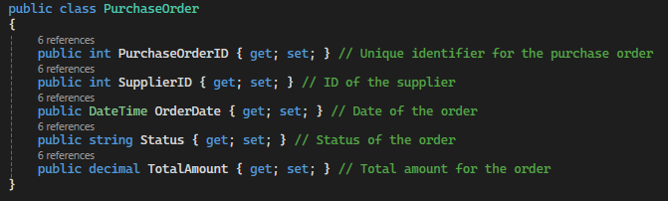
Code Snippet

Slide 65
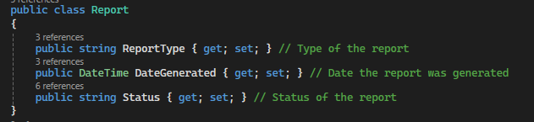
Code Snippet

Slide 66
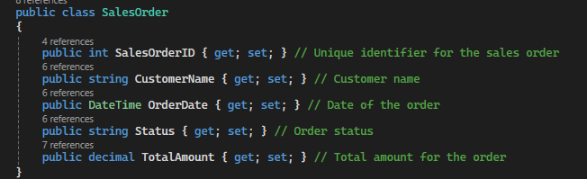
Code Snippet

Slide 67
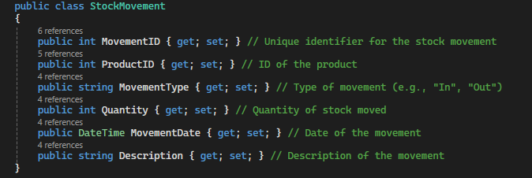
Code Snippet

Slide 68
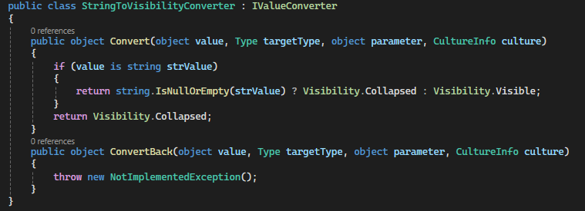
Code Snippet

Slide 69
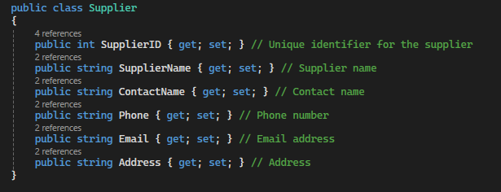
Code Snippet

Slide 70
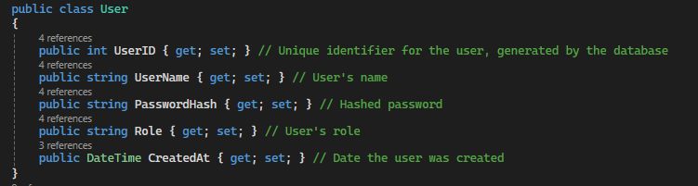
Code Snippet

Slide 71
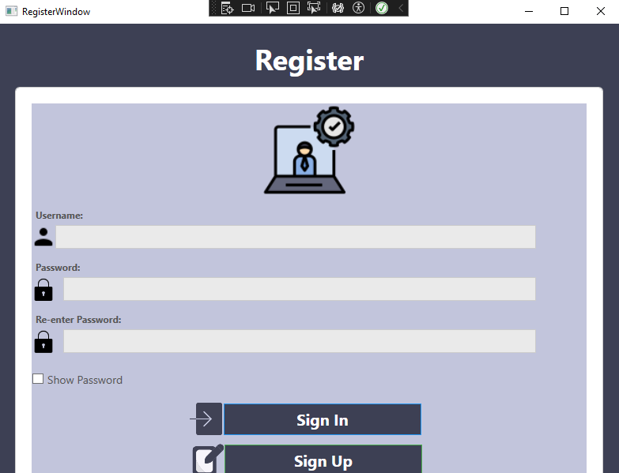
output

Slide 72
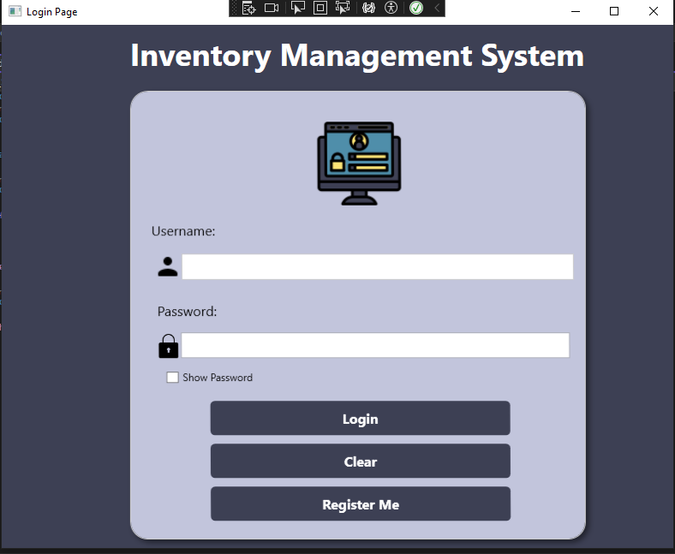
Code Snippet

Slide 73
output

Slide 74
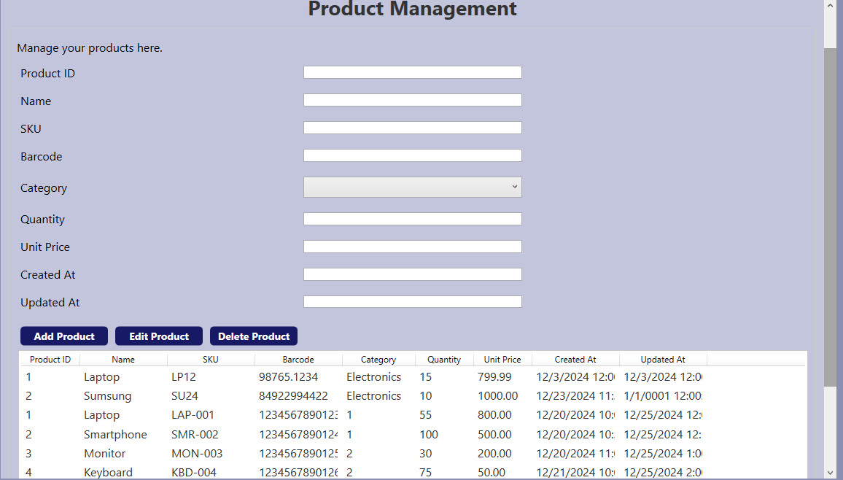
Output

Slide 75

output

Slide 76

Output

Slide 77

OUTPUT

Slide 78

Code Snippet

Slide 79

Output

Slide 80

Output

Slide 81
output

Slide 82

Code Snippet

Slide 83

output

Slide 84

Output

Slide 85

output

Slide 86

Output

Slide 87

Scope
Real-time tracking and management of stock levels across multiple locations.
Integration with order and supplier management processes.
Comprehensive reporting and analytics for informed decision-making.
User access control, mobile access, and compliance with industry standards.
Clearly defined limitations and exclusions, such as non-inclusion of financial accounting features

Slide 88
Conclusion
: Conclusion
Title: Final Thoughttent:
IMS is a scalable, secure, and comprehensive solution.
Streamlines operations, enhances decision-making, and ensures compliance.
Future-proof design for evolving business needs.
IMS is a scalable, secure, and comprehensive solution.
Streamlines operations, enhances decision-making, and ensures compliance.
Future-proof design for evolving business needs.

Slide 89
any questions ?

Slide 90
THANK YOU

